Slide 1
CYBER SECURITY
SQL Injection & Burpsuite
Faculty Mentor
Dr. Devika Kataria
Group Memebers
Esikela Venkata SaiSaran(2020BTechCSE106
Raneru Venkatesh(2020BTechCSE107)

Slide 2
INTRODUCTION
Attack
01
04
Roles
Demo
02
05
Defending
03
ABOUT SQL INJECTION AND BURPSUITE
Decrypting Passwords
SQL INJECTION AND BURPSUITE
Snapshots of burpsuite
Link
06
Hashing Passwords
Website link

Slide 3
INTRODUCTION
01
SQL Injection
SQL injection is a type of cyber attack in which the attacker injects malicious code into a website's database through user input fields, such as login forms or search boxes. This allows the attacker to gain access to sensitive information or even take control of the entire website.
To defend against SQL injection attacks, developers must thoroughly sanitize and validate all user input before it is sent to the database. This can be done by using prepared statements or parameterized queries, which separate the user input from the actual SQL code.

Slide 4
INTRODUCTION
02
Roles
The Role of Burp Suite in Defending Against SQL Injection Attacks. The Importance of Hashed Values in User Authentication Attacking Hashed Values with Brute Force Techniques Convees Backrting Hashed Valu into Plain Text
Conclusion: Protecting Against SQL Injection and Brute Force Attacks

Slide 5
The Role of Burp Suite in Defending Against SQL Injection Attacks
Burp Suite is a powerful web application security testing tool that can help defend against SQL injection attacks. It works by intercepting the traffic between the user's browser and the web server, allowing the developer to inspect and modify the requests and responses.
One way to use Burp Suite to defend against SQL injection attacks is to perform a vulnerability scan on the website. This will identify any potential vulnerabilities and provide suggestions for how to fix them.

Slide 6
03
Defending
Hashing Passwords
As a defender of the website, I recommend that all user passwords are hashed before reloading into the database. Hashing is a process of converting plain text passwords into a fixed-length string of characters that is unique to the original password. This makes it difficult for attackers to reverse engineer the password and gain unauthorized access to user accounts. As a defender of the website, I recommend that all user passwords are hashed before reloading into the database. Hashing is a process of converting plain text passwords into a fixed-length string of characters that is unique to the original password. This makes it difficult for attackers to reverse engineer the password and gain unauthorized access to user accounts.

Slide 7
04
Attacker
Decrypting Passwords
As an attacker, I could use a proxy server to intercept traffic between the user's browser and the website's server, allowing me to view sensitive information, such as passwords. By intercepting and analyzing the traffic, I could potentially find the password that the user entered and gain unauthorized access to their account.
To intercept traffic, I would first set up a proxy server and configure my browser to use the proxy. Then, when the user logs in to the website, their login credentials would be sent through the proxy server, which I could then intercept and analyze using tools like Wireshark or Burp Suite.

Slide 8

Converting Hashed Values Back into Plain Text
If a hacker is able to crack the hash and obtain the plain text password, they can then use this information to gain access to the user's account and potentially steal sensitive information.
To prevent this, developers should never store plain text passwords in the database. Instead, they should use a one-way hashing algorithm to convert the password into a unique string of characters that cannot be reversed

Slide 9
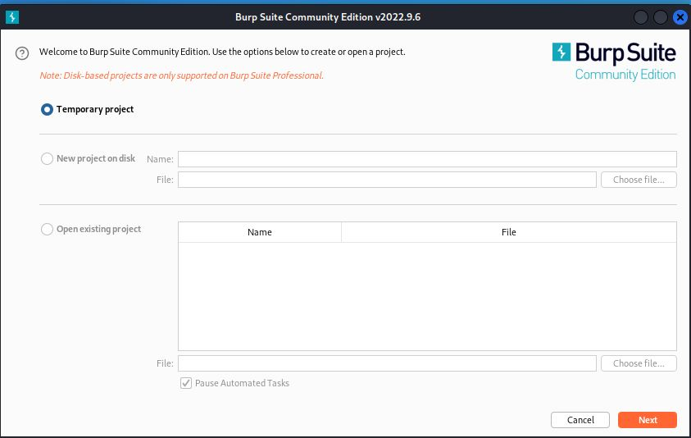
05
DEMO
Burpsuite

Slide 10
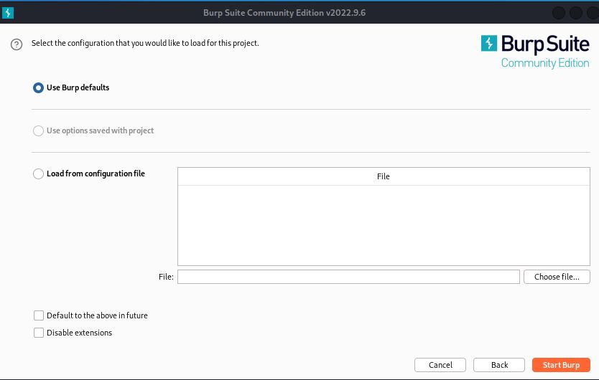
Burpsuite

Slide 11
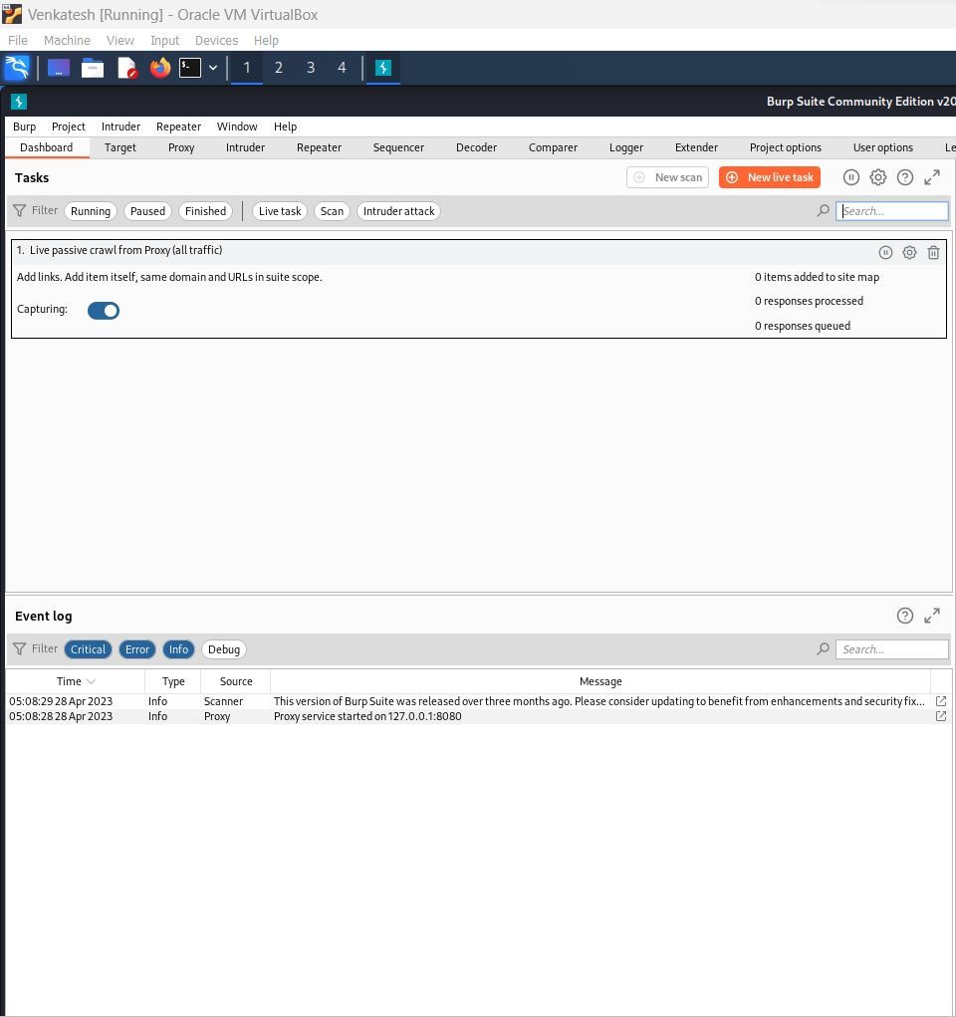
Burpsuite

Slide 12
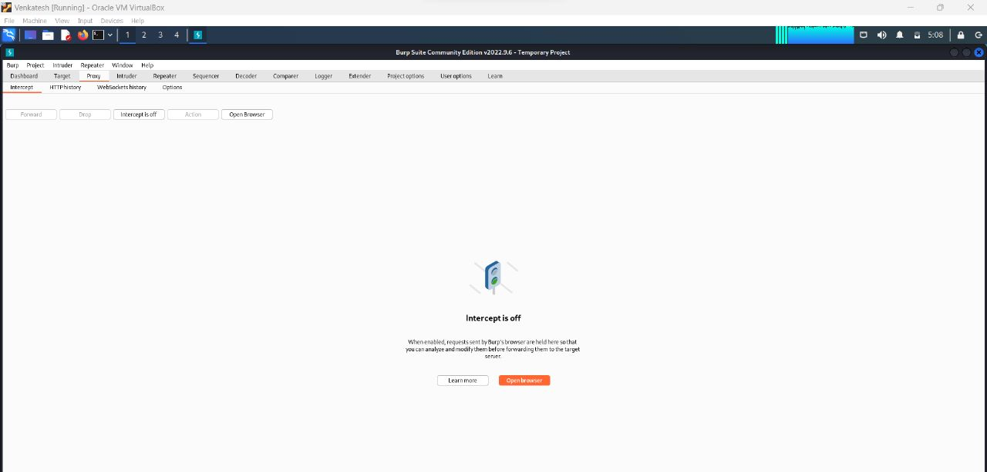
Burpsuite

Slide 13


Burpsuite

Slide 14
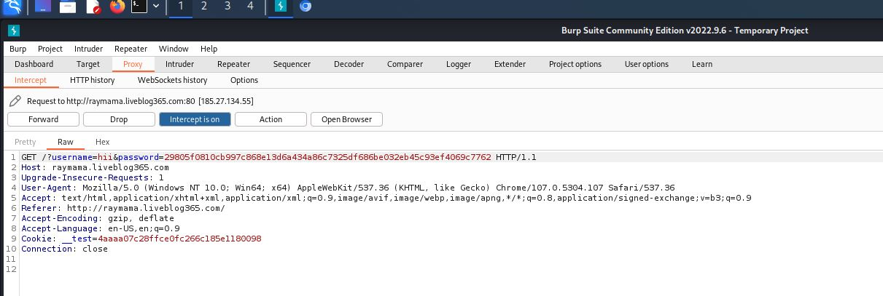
Burpsuite

Slide 15
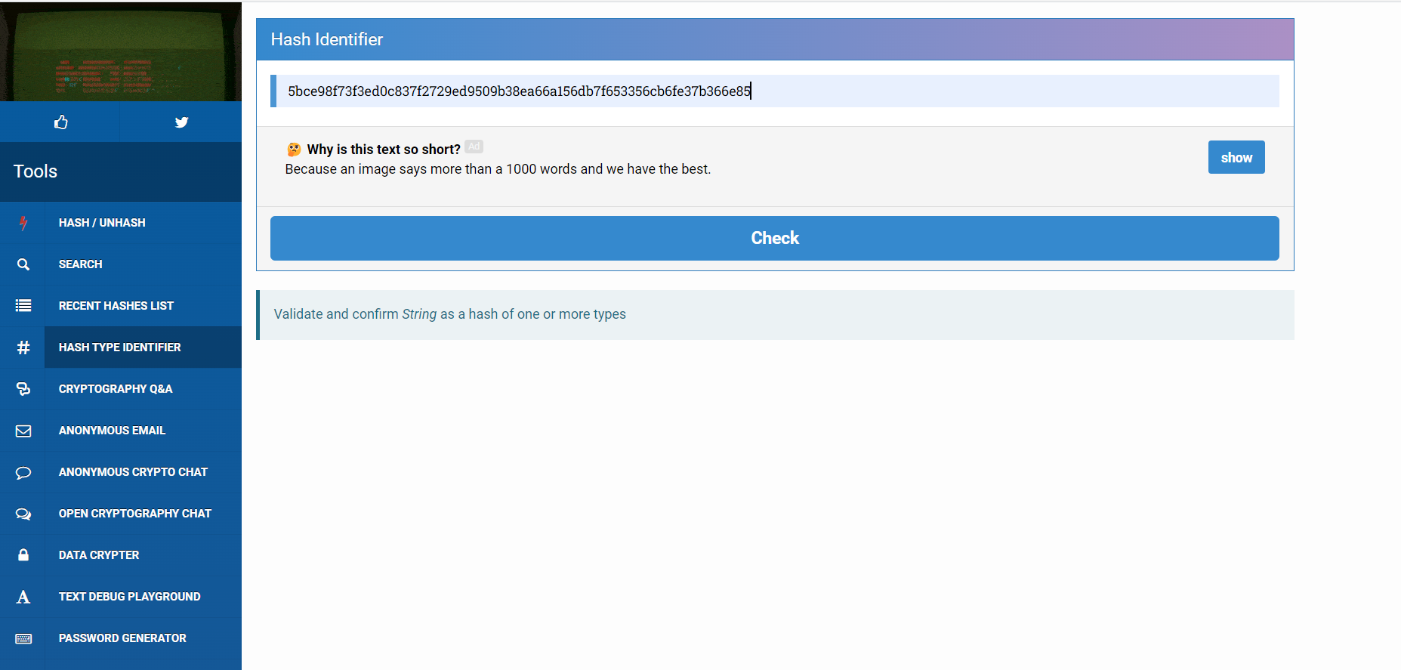
Hash Identifier

Slide 16
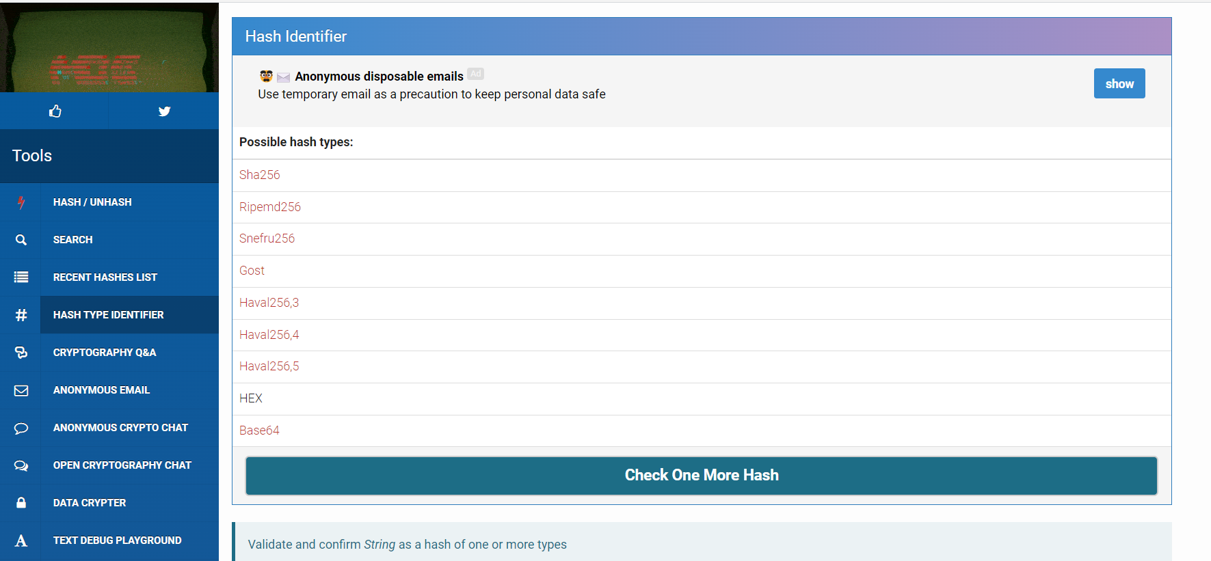
Hash Identifier

Slide 17
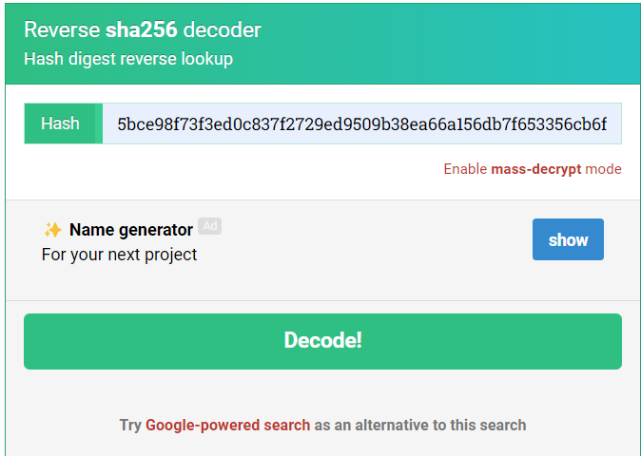
Hash Identifier

Slide 18
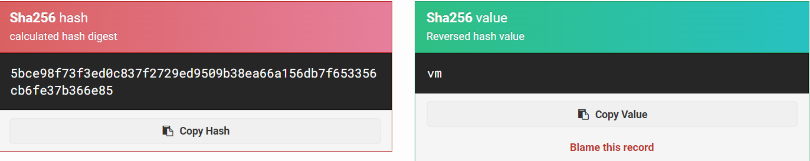
Hash Identifier

Slide 19
06
WEBSITE LINK
http://mamabro.liveblog365.com/

Slide 20







THANKS!

